Slide 1
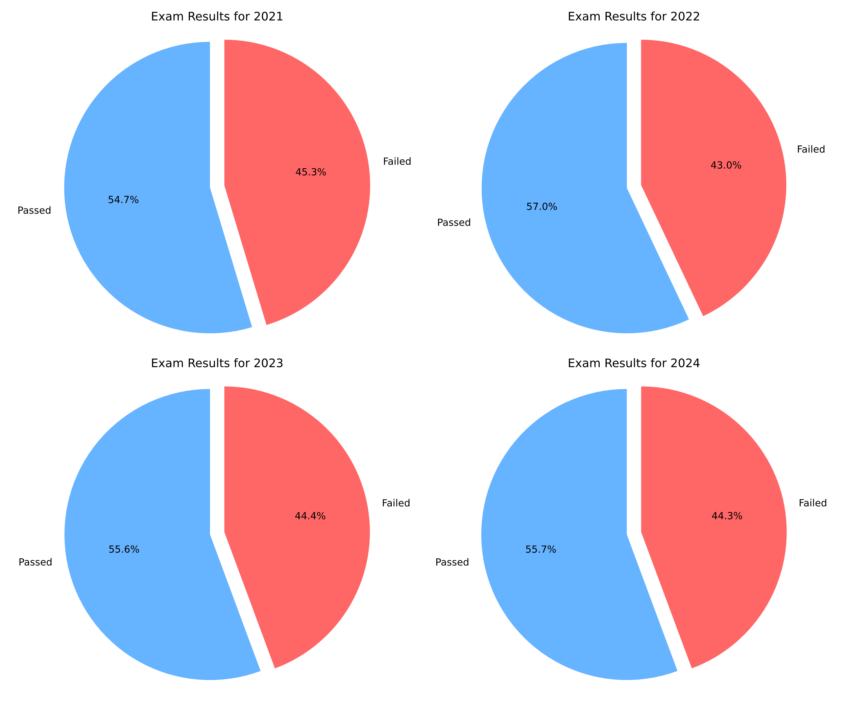
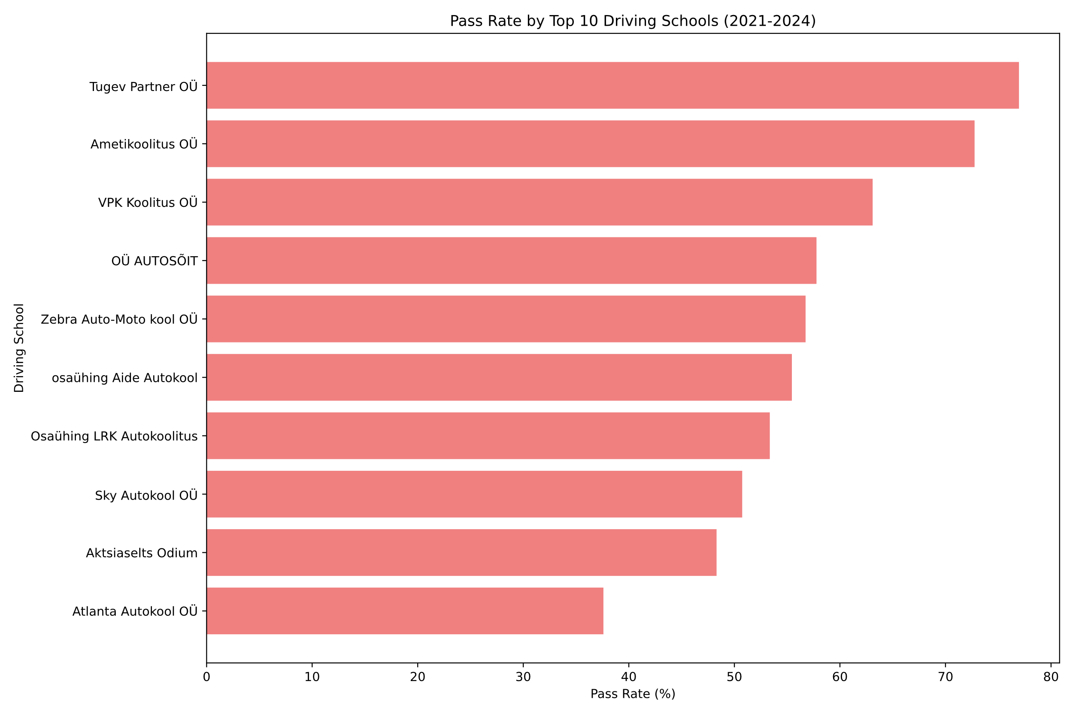
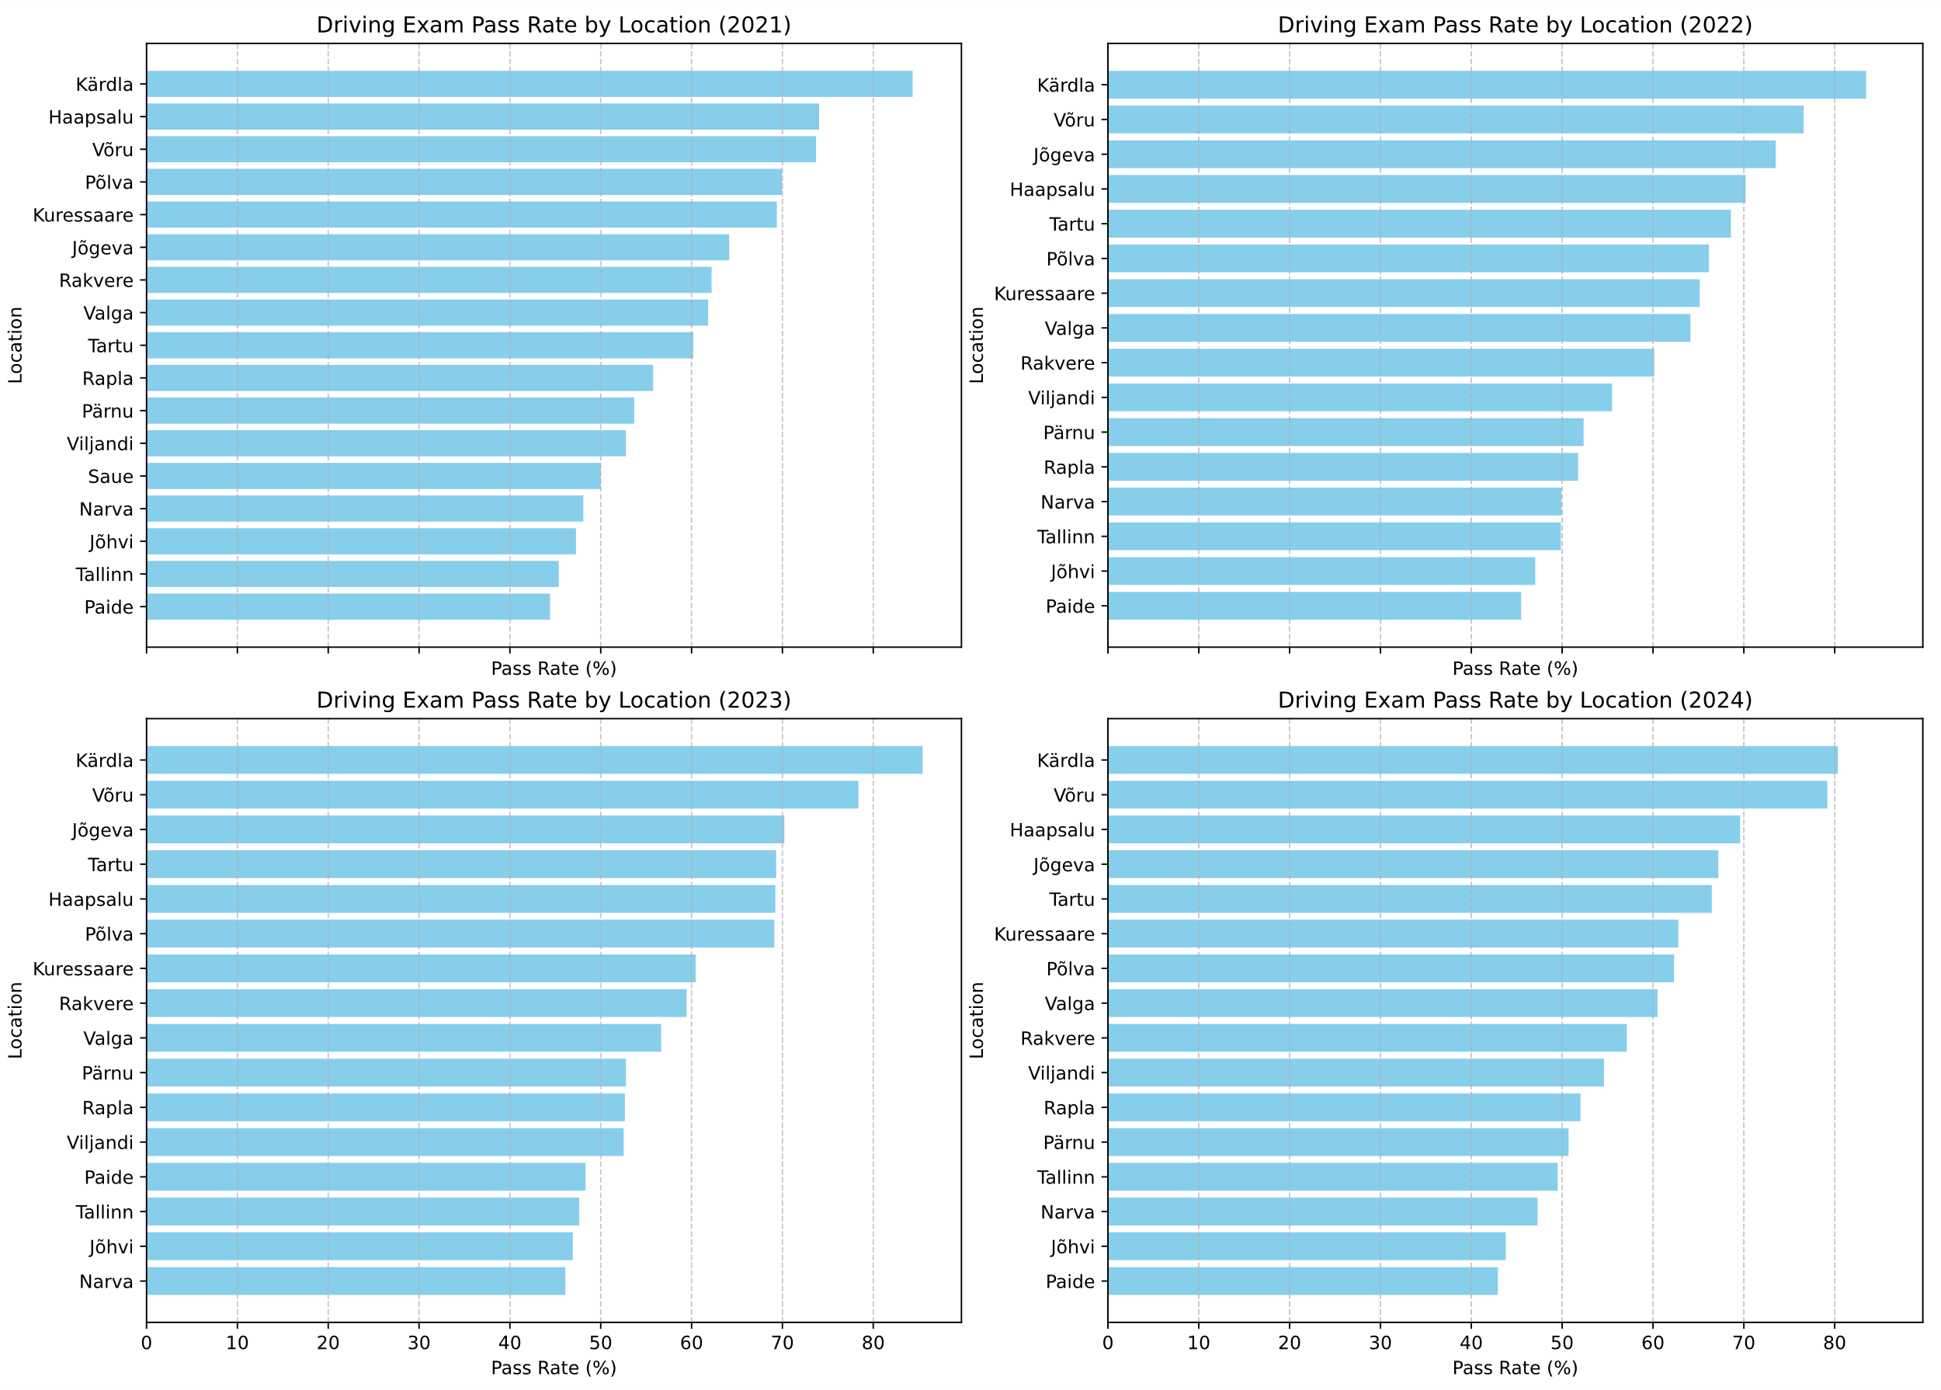
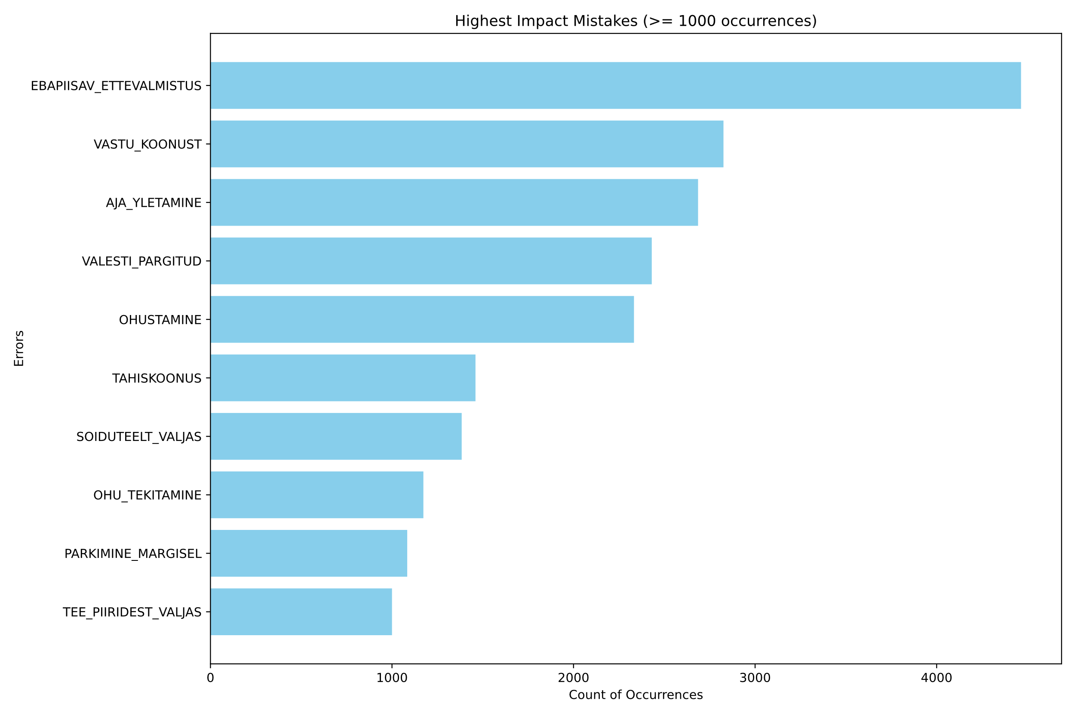
Estonian Driving Exams Hannes Kolk, Erik Kippus 2024
Introduction
Driving exams represent a consistent and significant milestone for students, serving as both a practical assessment of their acquired knowledge and skills and a critical step toward achieving personal mobility and independence. Thus, we decided to analyse data from Estonian driving schools to identify patterns and factors influencing outcomes.
The project is based on public datasets provided by Eesti Transpordiamet (via avaandmed.eesti.ee). The provided data consists of 4 csv files for each year with driving exams’ information.
As for the software used, we went for ‘pandas’ for the data mining, ‘seaborn’ and ‘matplotlib’ for visualisation.
Objectives
We decided to focus on 4 primary subjects:
Analysis of exam success rates per year
Analysis of driving school choice and driving exam results
Highest impact mistakes by occurrence
Analysis of success rates by location of exam
Our goals were based on experience, as these are the most common questions people debate about.
Results
Analysis of exam success rates per year
The analysis shows that the results are generally around 50% for both passing the exam and failing it. However, every year the passing amount is slightly higher, around 5%.
2. Analysis of driving school choice and driving exam results
We decided to analyse driving school results for all years available, and displayed the 10 most popular schools and the school’s students’ pass rates.
3. Highest impact mistakes by occurrence
Analysis of mistakes gave insight into what are the most common ones made. The result is difficult to interpret, as the provided datasets featured an unclear element “EBAPIISAV_ETTEVALMISTUS”.
4. Analysis of success rates by location of exam
We decided to analyse the locations for each year, though the results didn’t show much variation. The locations with the highest pass rates appear to persist since 2021.
Conclusions
Our analysis of Estonian driving exams from 2021 to 2024 revealed significant variability in exam success rates across driving schools and exam locations. Tugev Partner OÜ and Ametikoolitus OÜ displayed significantly higher results, though 8 of the 10 major driving schools had results above 50%. Success rates per location were mostly dominated by the same locations, Kärdla appears to be the most successful location; Võru, Jõgeva, Haapsalu and Tartu also displayed very positive results. The capital city Tallinn however ranked poorly, generally below 50%. Analysis of mistakes made by students is difficult to interpret, as it featured an unclear mistake, poor preparation. This same feature was the most severe one, as more than 4000 students encountered it. This could provide motivation to individuals taking the exam to prepare. The other significant mistakes are fairly self-explanatory, hitting a cone and going over the time limit are practical mistakes. On another note, analysis of success rates did not give much insight, results are generally around 50% for each year and no clear trend or pattern can be derived.
We hope that this analysis helps people interested in getting their driver’s license in their decision-making, abilities and preparation.

